Slide 1
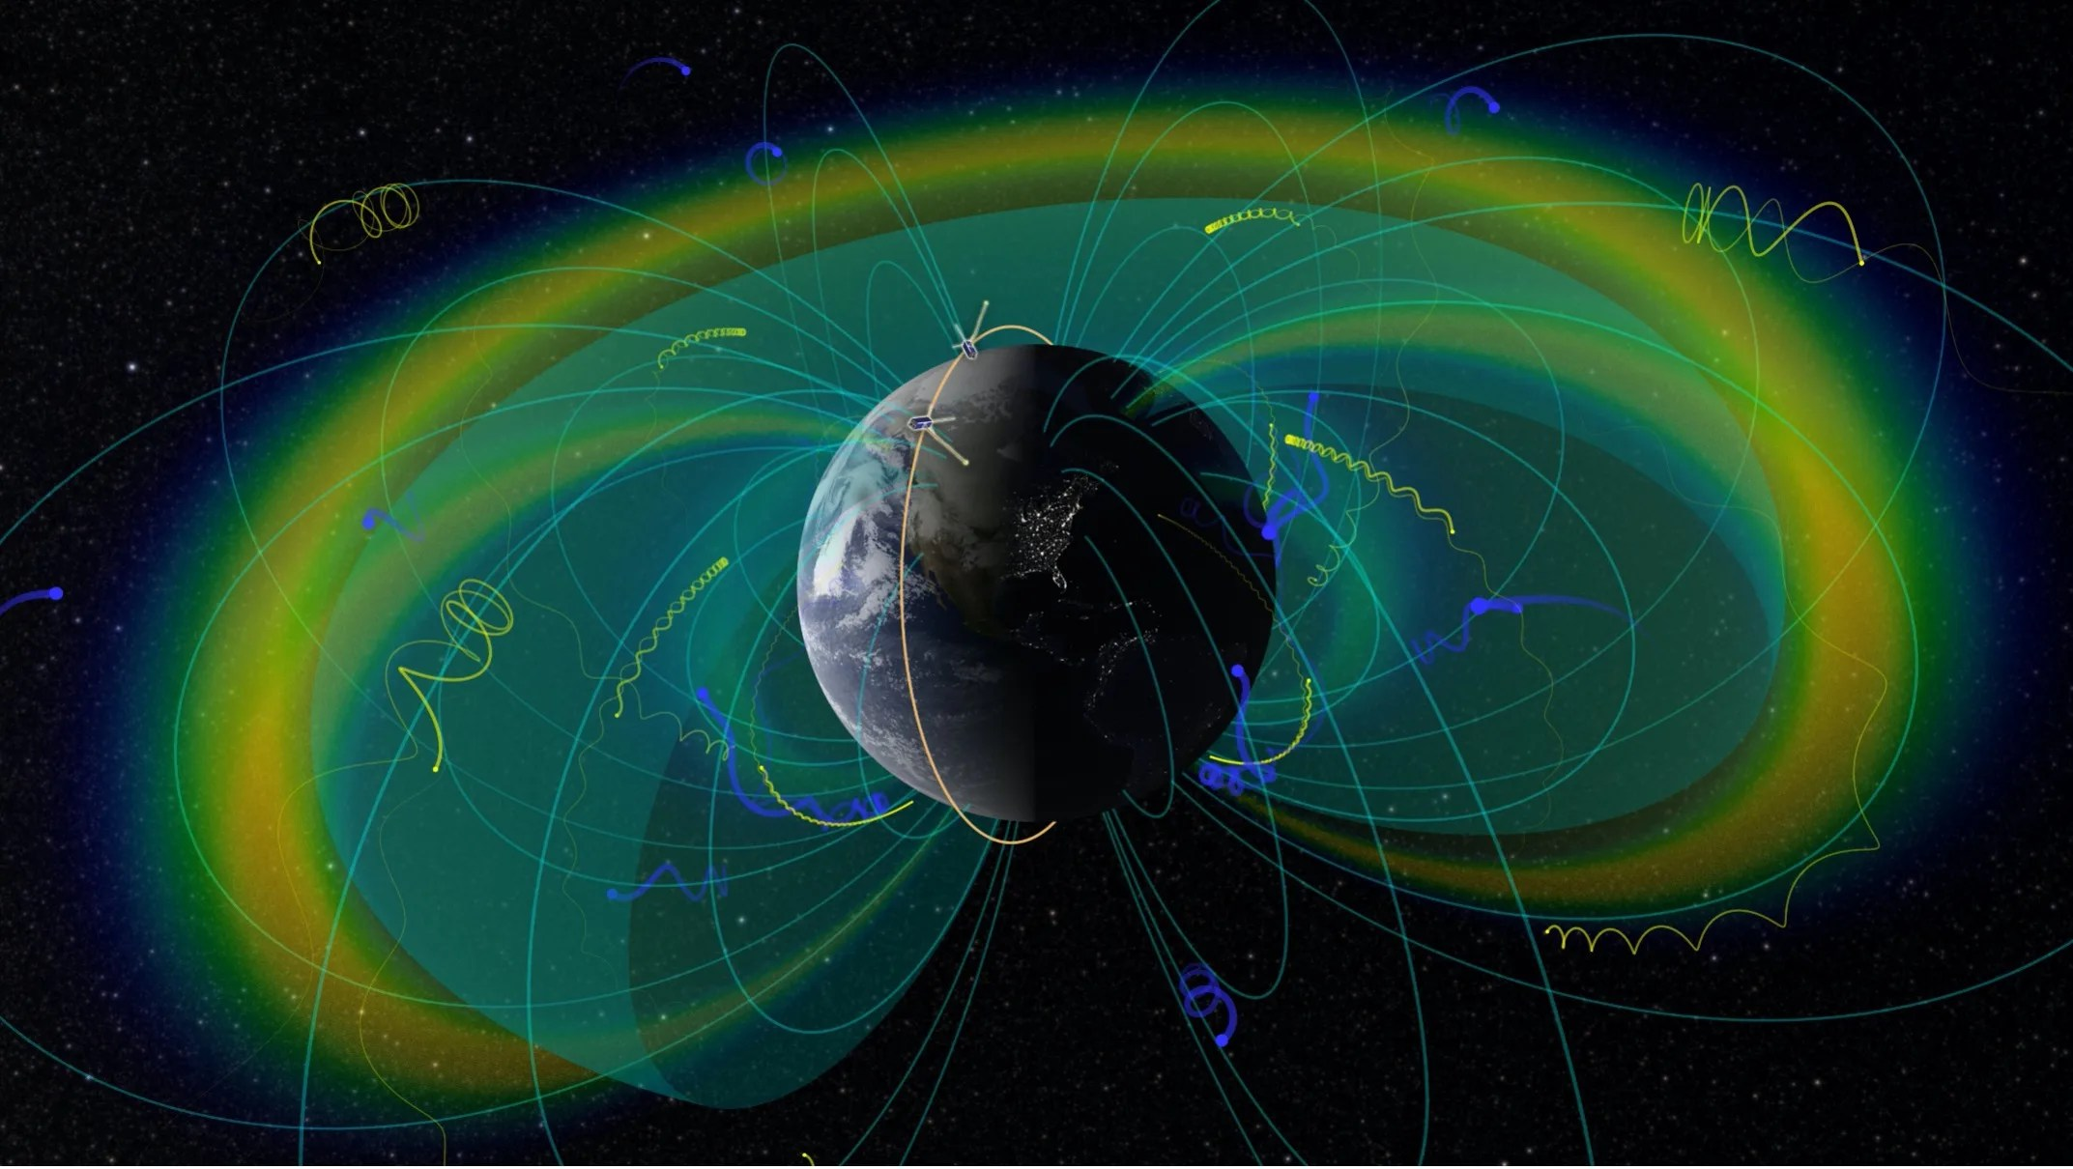
ELFIN Mission
Brought to you by: Kai Chen | University of Maryland
Mentored by Dr. Mei-Ching, Cristian, and Suk-Bin
“ELFIN”, NASA

Slide 2
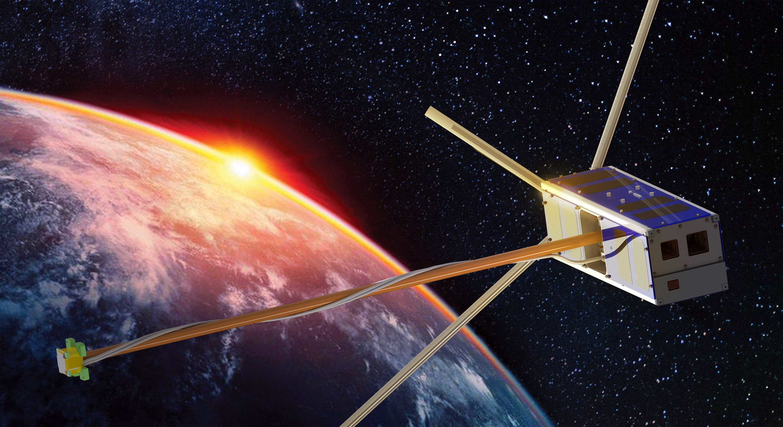
Why do we need ELFIN?
- ELECTRON LOSSES AND FIELDS INVESTIGATION (2 satellites)
- Energetic Loss Particles
- Aid modeling and predicting
space weather
“ELECTRON LOSSES AND FIELDS INVESTIGATION”, UCLA

Slide 3
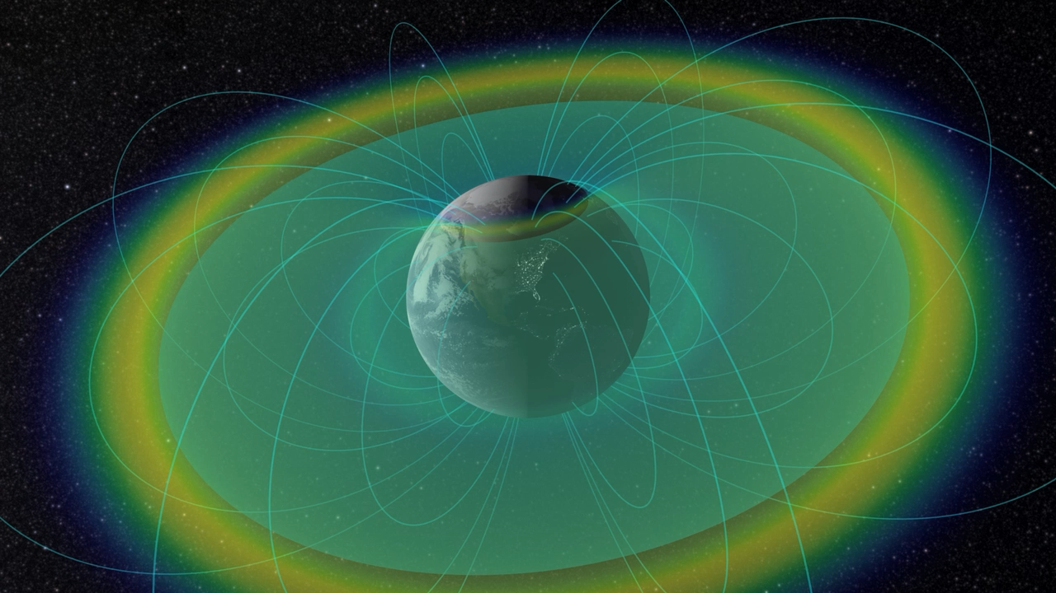
“Radiation Belts & Plasmapause”, Tom Bridgman

Slide 4
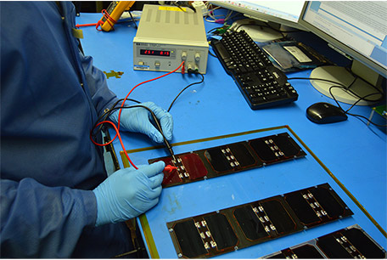
The ELFIN Mission and Particle Data
PI: Vassilis Angelopoulos (UCLA)
250+ students
Launch on Sept. 15, 2018
Deorbited on Sept. 17 (A) and 30 (B), 2022
ELFIN A’s ion & electron data:
6/29/2022 – 9/17/2022
ELFIN B’s ion & electron data:
7/06/2022 – 9/30/2022
We studied two geomagnetic storms between
2022-07-06 to 2022-07-09,
and
2022-07-18 to 2022-07-20
“ELECTRON LOSSES AND FIELDS INVESTIGATION”, UCLA

Slide 5
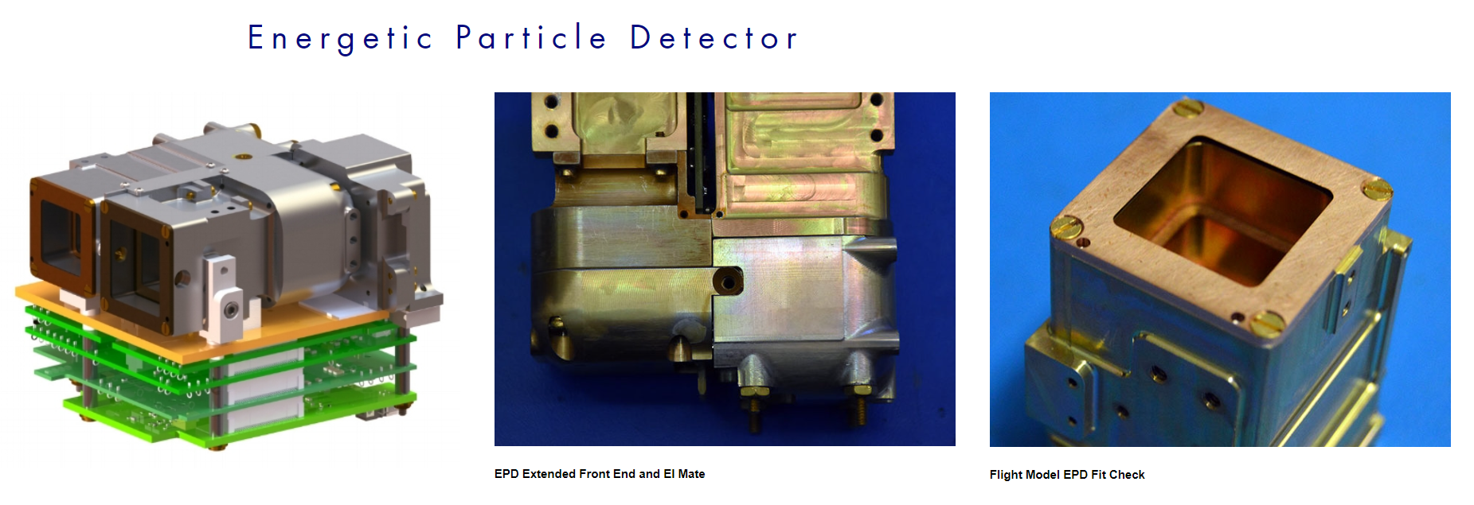
Instruments
- for ions and electrons
“Instruments”, UCLA

Slide 6
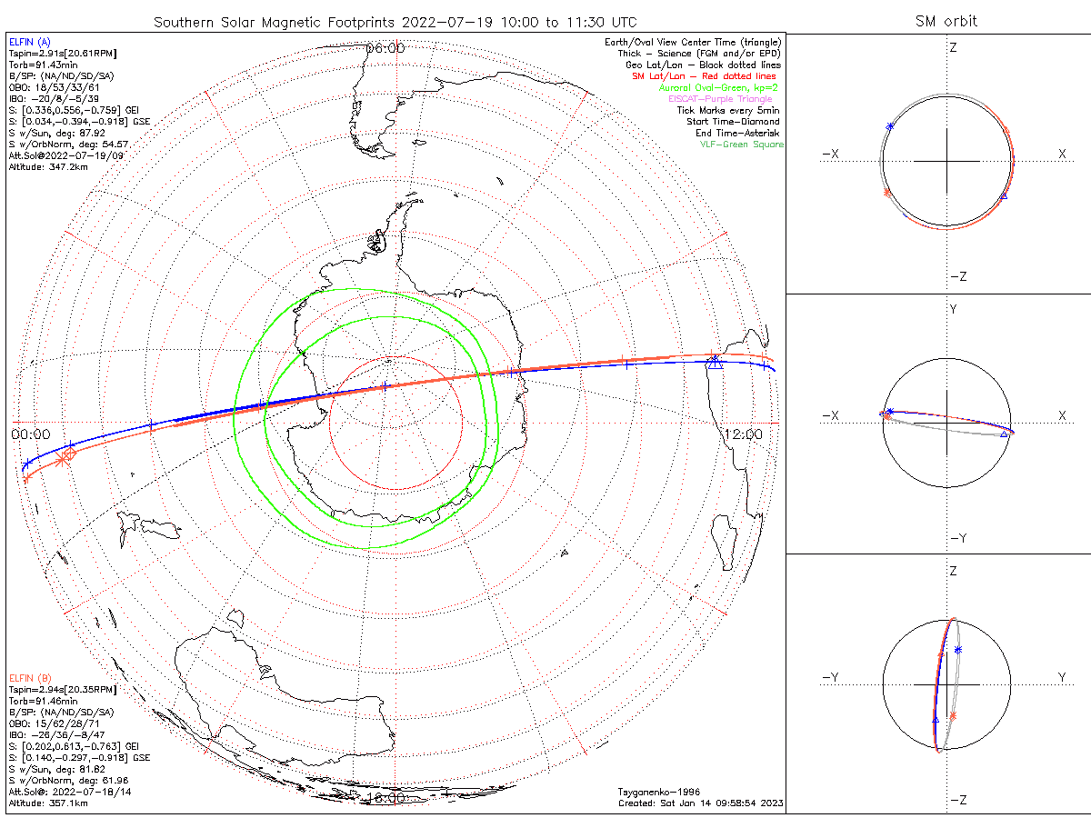
ELFIN’s Orbit
Solar Magnetic (SM) Position
Roughly 450 km altitude
Period of 91.43 minutes
91 minutes and 26 seconds
(roughly 15 times per day)
Polar ~93° inclination

Slide 7
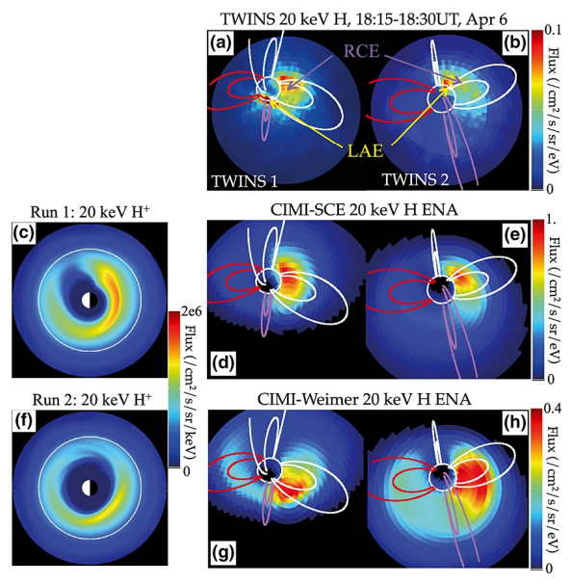
What is the Project goal?
- Produce spectrograms like journals’ figures of the particles at flux tubes during geomagnetic storms
- Compare observational data to
the Comprehensive Inner
Magnetosphere-ionosphere
(CIMI) model
Fok, M.-C., N. Y. Buzulukova, S.-H. Chen, A. Glocer, T. Nagai, P. Valek, and J. D. Perez (2014), The Comprehensive Inner Magnetosphere-Ionosphere Model, J. Geophys. Res. Space Physics, 119, 7522–7540, doi:10.1002/2014JA020239.

Slide 8
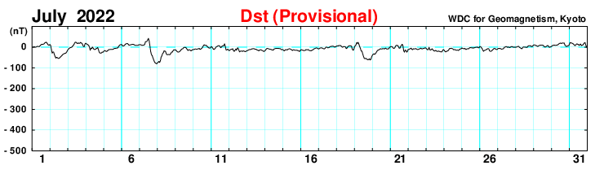
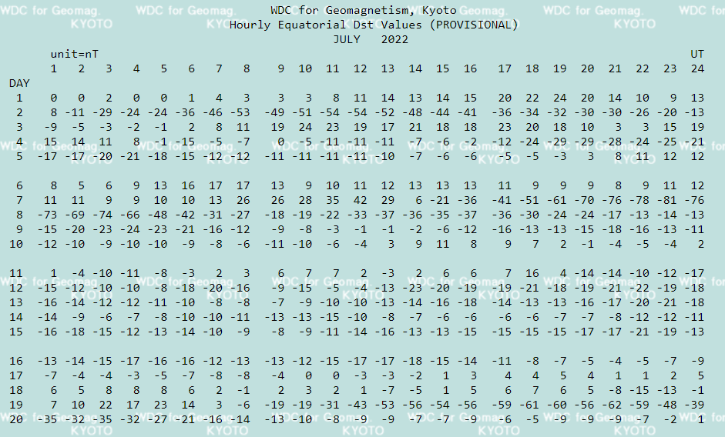
Storms Galore (Disturbance storm time index)
B = B₀ + ∆B

Slide 9
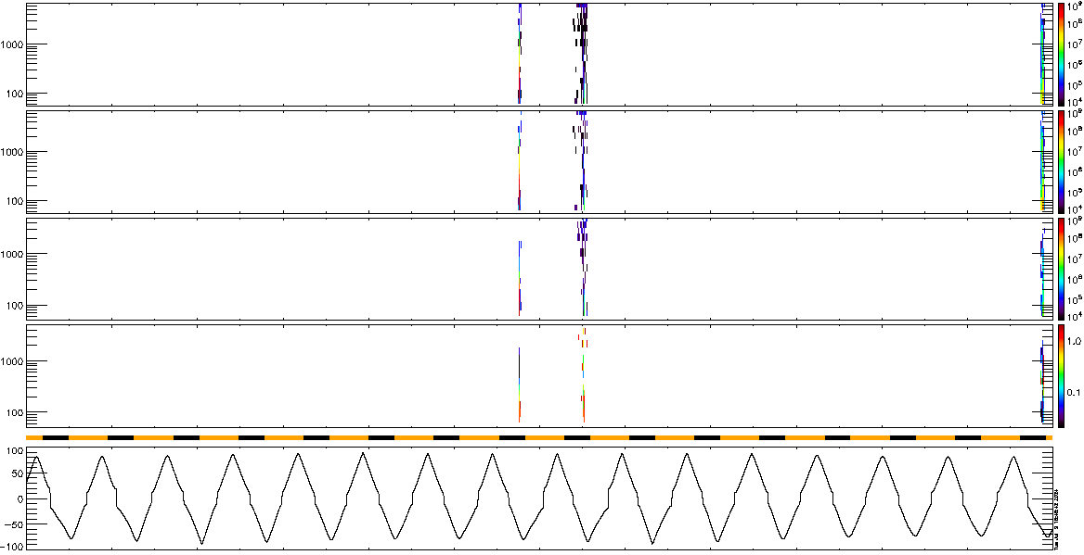
7/18/2022 (24hr)
Energetic Particle Detector for electrons
ELFIN-A, Electron-Flux, alt=348km
J_{OMNI}
keV/(cm²/sr/s/MeV)
e-flux
J_{ꓕ}
keV/(cm²/sr/s/MeV)
e-flux
J_{prec}
keV/(cm²/sr/s/MeV)
e-flux
J_{prec} / J_{ꓕ}
keV/(cm²/sr/s/MeV)
ratio
Sun / Shadow
MLAT
UT
00:00
04:00
08:00
12:00
16:00
20:00

Slide 10
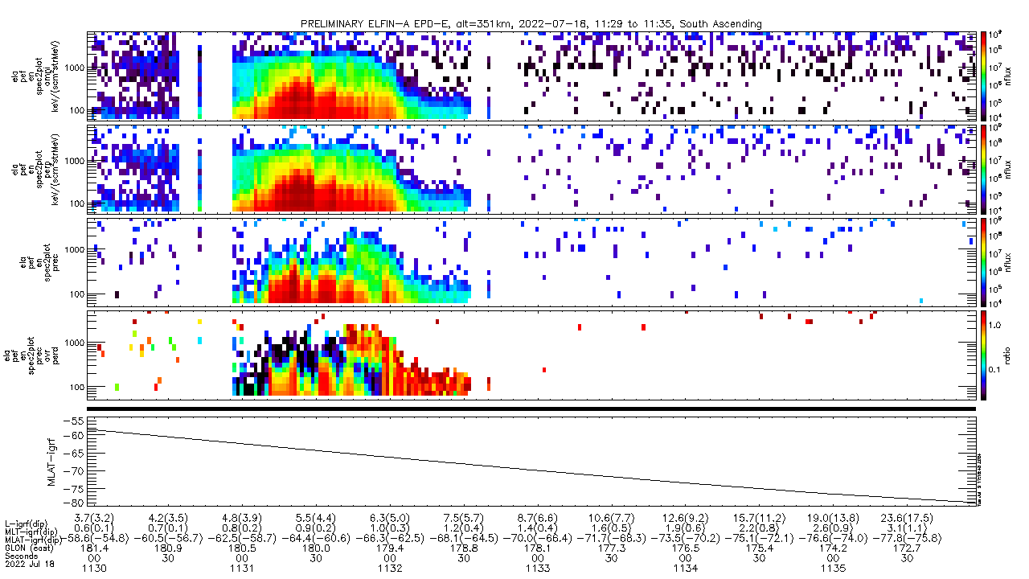
7/18/2022 (11:29:57 – 11:35:58)
Energetic Particle Detector for electrons
ELFIN-A, Electron-Flux, alt=351km, South Ascending
J_{OMNI}
keV/(cm²/sr/s/MeV)
e-flux
J_{ꓕ}
keV/(cm²/sr/s/MeV)
e-flux
J_{prec}
keV/(cm²/sr/s/MeV)
e-flux
J_{prec} / J_{ꓕ}
keV/(cm²/sr/s/MeV)
ratio
Sun / Shadow
MLAT
UT
11:30
11:31
11:32
11:33
11:34
11:35

Slide 11
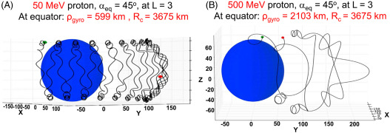
7/18/2022 (11:29:57 – 11:35:58)
Energetic Particle Detector for electrons
ELFIN-A, Electron-Flux, alt=351km, South Ascending
J_{OMNI}
keV/(cm²/sr/s/MeV)
e-flux
J_{ꓕ}
keV/(cm²/sr/s/MeV)
e-flux
J_{prec}
keV/(cm²/sr/s/MeV)
e-flux
J_{prec} / J_{ꓕ}
keV/(cm²/sr/s/MeV)
ratio
Sun / Shadow
MLAT
UT
11:30
11:31
11:32
11:33
(this section is inaccurate)
“Particle Precipitation”, ScienceDirect

Slide 12
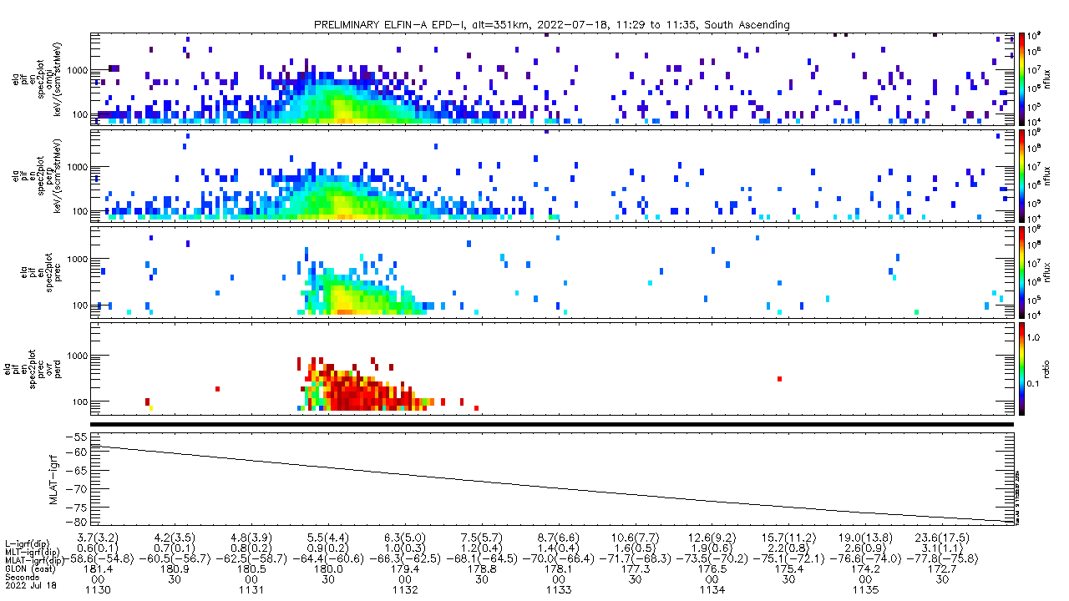
7/18/2022 (11:29:57 – 11:35:58)
Energetic Particle Detector for ions
ELFIN-A, Ion-Flux, alt=351km, South Ascending
J_{OMNI}
keV/(cm²/sr/s/MeV)
e-flux
J_{ꓕ}
keV/(cm²/sr/s/MeV)
e-flux
J_{prec}
keV/(cm²/sr/s/MeV)
e-flux
J_{prec} / J_{ꓕ}
keV/(cm²/sr/s/MeV)
ratio
Sun / Shadow
MLAT
UT
11:30
11:31
11:32
11:33
11:34
11:35

Slide 13
7/18/2022 (11:30 – 11:33)
Energetic Particle Detector for both electrons and ions
ELFIN-A, E-flux vs Ion-Flux, alt=351km, South Ascending
J_{OMNI}
keV/(cm²/sr/s/MeV)
e-flux
J_{ꓕ}
keV/(cm²/sr/s/MeV)
e-flux
J_{prec}
keV/(cm²/sr/s/MeV)
e-flux
J_{prec} / J_{ꓕ}
keV/(cm²/sr/s/MeV)
ratio
Sun / Shadow
MLAT
(this section is inaccurate)
UT
11:30
11:31
11:32
11:30
11:31
11:32
11:33

Slide 14
Conclusion
Results:
We recreated the spectrograms from ELFIN publication figures
What did we learn:
I learned how to code in IDL and utilize SPEDAS
And learned the mechanisms of energetic loss particles and particle scattering due to field line distortion
Our next steps:
ELFIN spectrograms vs CIMI spectrograms

Slide 15
Acknowledgements
Drs. Mei-Ching Fok¹, Cristian Ferradas¹, and Suk-Bin Kang¹
Drs. Alex Young¹, Eliah Sabbas¹, Barbara Thompson¹,
(for presentation practice)
Colin Wilkins², and Anton Artemyev²
¹NASA Goddard Space Flight Center
²ELFIN team at UCLA

Slide 16
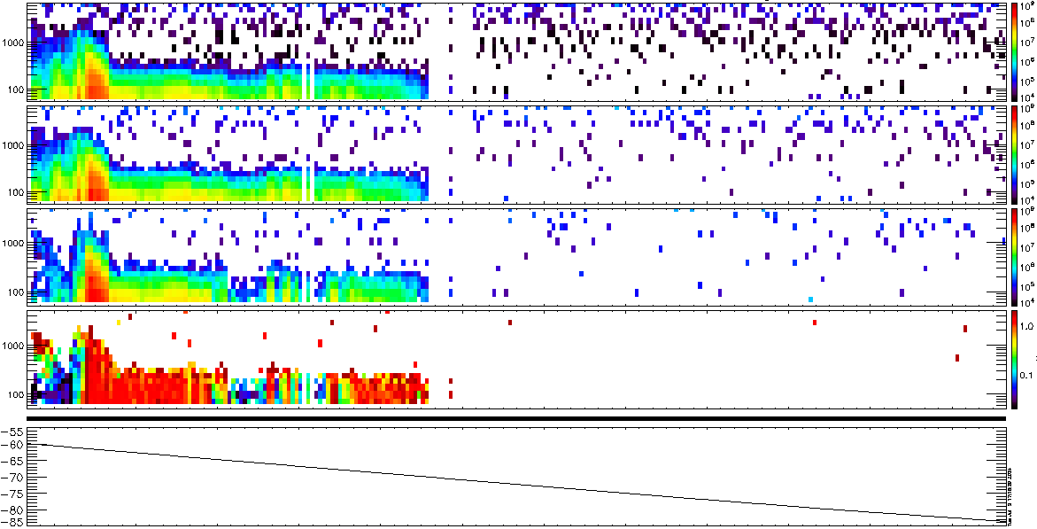
7/19/2022 (13:22:20 – 13:28:20 UTC)
ELFIN-A, Electron Energy Flux, alt=350km, South Ascending
Strong J_{prec}/ J_{ꓕ} represents strong precipitation and significant particle losses.
Strong loss due to wave-particle scattering at mid-latitudes.
Strong loss due to field-line curvature scattering at higher latitudes.
J_{OMNI}
keV/(cm²/sr/s/MeV)
e-flux
J_{ꓕ}
keV/(cm²/sr/s/MeV)
e-flux
J_{prec}
keV/(cm²/sr/s/MeV)
e-flux
J_{prec} / J_{ꓕ}
keV/(cm²/sr/s/MeV)
ratio
Sun / Shadow
MLAT
UT
13:23
13:24
13:25
13:26
13:27
13:28

Slide 17
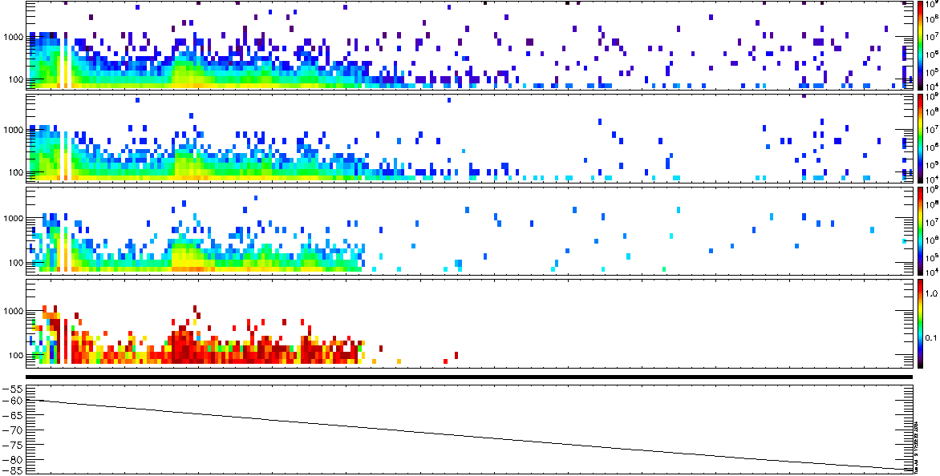
7/19/2022 (13:22:20 – 13:28:20 UTC)
ELFIN-A, Ion Energy Flux, alt=350km, South Ascending
J_{OMNI}
keV/(cm²/sr/s/MeV)
e-flux
J_{ꓕ}
keV/(cm²/sr/s/MeV)
e-flux
Strong J_{prec}/ J_{ꓕ} represents strong precipitation and significant particle losses.
Strong loss due to field-line curvature scattering
J_{prec}
keV/(cm²/sr/s/MeV)
e-flux
J_{prec} / J_{ꓕ}
keV/(cm²/sr/s/MeV)
ratio
Sun / Shadow
MLAT
UT
13:23
13:24
13:25
13:26
13:27
13:28

Slide 18
7/18/2022 (11:29:57 – 11:35:58)
ELFIN-A, Electron Energy Flux, alt=351km, South Ascending
Strong J_{prec}/ J_{ꓕ} represents strong precipitation and significant particle losses.
Strong loss due to wave-particle scattering at mid-latitudes.
Strong loss due to field-line curvature scattering at higher latitudes.
J_{OMNI}
keV/(cm²/sr/s/MeV)
Strong J_{prec}/ J_{ꓕ} represents strong precipitation and significant particle losses.
Strong loss due to wave-particle scattering at mid-latitudes.
Strong loss due to field-line curvature scattering at higher latitudes.
e-flux
J_{ꓕ}
keV/(cm²/sr/s/MeV)
e-flux
J_{prec}
keV/(cm²/sr/s/MeV)
e-flux
J_{prec} / J_{ꓕ}
keV/(cm²/sr/s/MeV)
ratio
Sun / Shadow
MLAT
UT
11:30
11:31
11:32
11:33
11:34
11:35

Slide 19
7/18/2022 (11:29:57 – 11:35:58)
ELFIN-A, Ion Energy Flux, alt=351km, South Ascending
J_{OMNI}
keV/(cm²/sr/s/MeV)
e-flux
J_{ꓕ}
keV/(cm²/sr/s/MeV)
e-flux
Strong J_{prec}/ J_{ꓕ} represents strong precipitation and significant particle losses.
Strong loss due to field-line curvature scattering
J_{prec}
keV/(cm²/sr/s/MeV)
e-flux
J_{prec} / J_{ꓕ}
keV/(cm²/sr/s/MeV)
ratio
Sun / Shadow
MLAT
UT
11:30
11:31
11:32
11:33
11:34
11:35

